Slide 1
Lesson objective
Title: Topic review
Aim:
Assign probability using Venn diagrams and two-way tables
Plan:
Review simplifying expressions
Using “AND” “OR”
Assigning probability

Slide 2
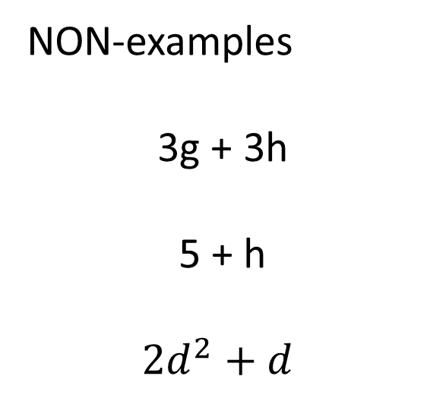
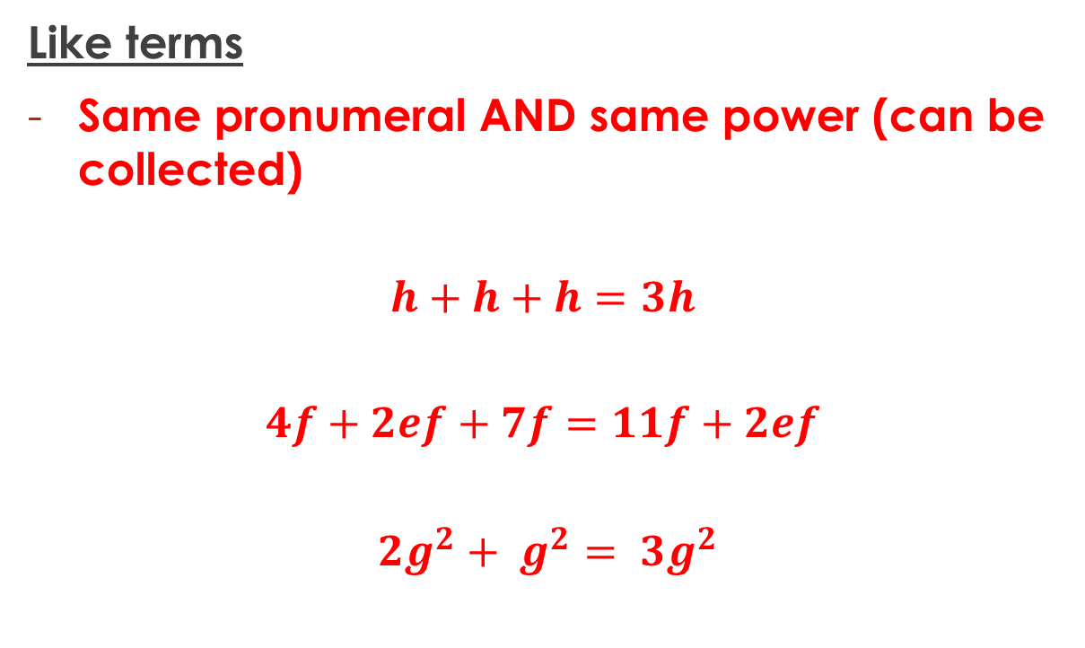
Terminology
Like terms
Same pronumeral AND same power (can be collected)
$$h+h+h=3h$$
$$4f+2ef+7f=11f+2ef$$
$${2g}^{2}+ g^{2}= {3g}^{2}$$
NON-examples
3g + 3h
5 + h
$${2d}^{2}+d$$

Slide 3
Practice 1 – simplify in exercise book
10e + 3e
3d + 5d
19x – 5x
10w + 3e + 2w + 5e
2d + 3d – 7d
2z + 3x + 6y + 4z – 2x + 4y
3x + 2x + 5y
-4f -2f + 8f
Answers
13e
8d
14x
12w + 8e
-2d
6z + x + 10y
5x + 5y
2f

Slide 4
Probability
$$P\left(event\right)=\frac{\# of favourable outcomes}{Total \# of outcomes}$$
A bag contains 5 red marbles, 6 blue marbles and 9 yellow marbles.
What is the probability of pulling out a red?
P(blue)?
P(not blue)?

Slide 5
Complimentary events
Complimentary event
The opposite of something happening
What is the opposite of ….
Rolling a 4?
Getting a tails?
Person owning a dog?

Slide 6
Terminology
And
Or
Means favourable outcomes MUST be both.
Means it can be one or the other or both.
E.g. a person who has blue eyes or blonde hair but not both (Exclusive)

Slide 7
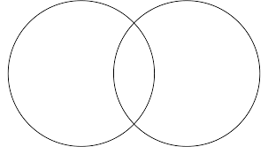
Netflix
Disney+
Students were asked which streaming service they liked.
U =
P(liked Netflix) =
P(only Disney+) =
P(liked both) =
Greg
Henry
Sam
Sally
Jay
Suzie
Tom
Rob
Tim
Hayley

Slide 8
Venn Diagrams – An Example
We do
The Venn diagram below shows two events D and F.
Find: a) P(D and F) b) P(Not D) c) P(D only)
d) P(D or F) e) P(Not D or F)
U =
D
F
10
6
5
9

Slide 9
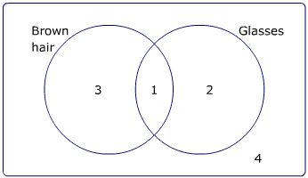
Whiteboards
Students were asked if they had brown hair or wore glasses.
How many students were asked?
If selected at random…
b) P(B hair and Glasses)
c) P(Only glasses)
d) P(brown hair or glasses)
e) P(not brown hair)
f) P(didn’t have either)

Slide 10
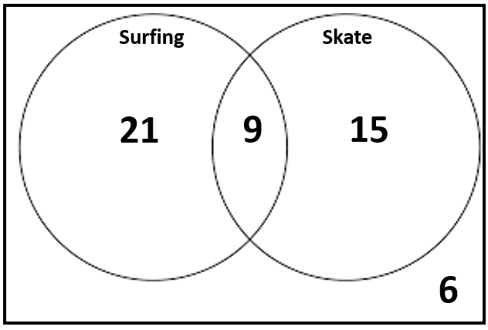
Whiteboards
Students were asked which hobby they like.
How many students were asked?
If selected at random…
b) P(surf and skate)
c) P(Only skate)
d) P(surf or skate)
e) P(not surf)
f) P(didn’t like either)

Slide 11
Whiteboards
300 people were asked if they have visited Bali or Fiji.
181 people have been to Fiji
163 people have been to Bali
54 people have been to both.
Draw a Venn diagram
How many people haven’t been to either?

Slide 12
Two-way tables
 | Soccer | Not soccer | Total
Volleyball | 21 | 18 | 39
Not volleyball | 12 | 9 | 21
Total | 33 | 27 | 60
Several students were asked what sports they play.
P(Playing soccer and volleyball)
P(Playing soccer or volleyball)
P(Playing only soccer)

Slide 13
Whiteboards
 | Surfing
Skate
Surfing
Skate
21
9
15
6

Slide 14
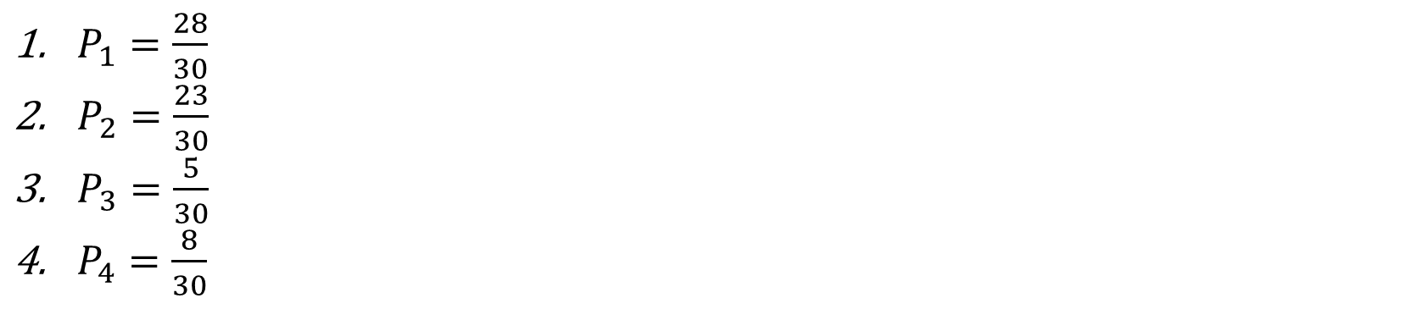
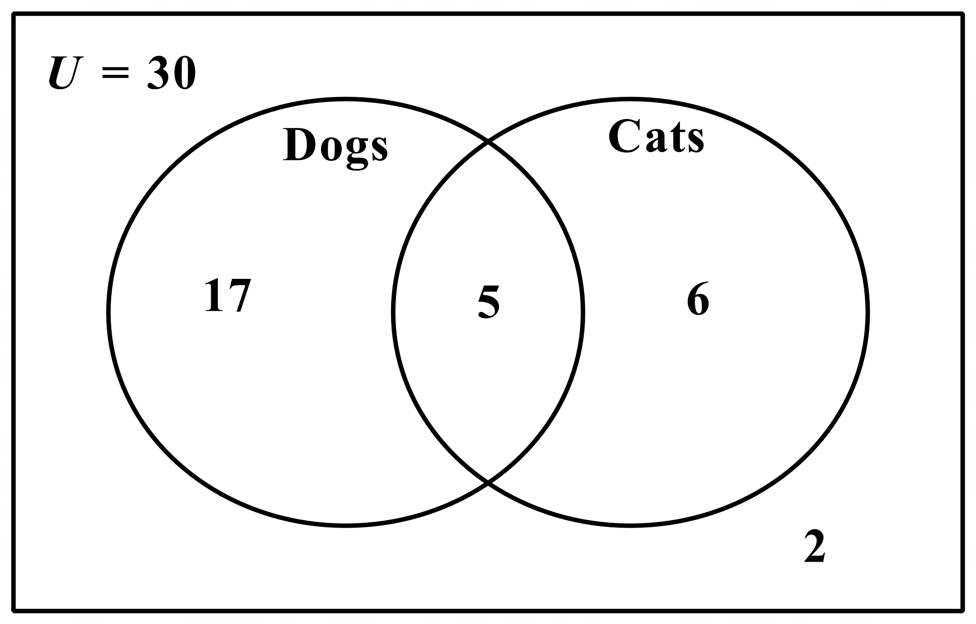
Describe what the following probabilities would represent in context to the Venn diagram using appropriate mathematical language.
$P_{1}=\frac{28}{30}$
$P_{2}=\frac{23}{30}$
$P_{3}=\frac{5}{30}$
$P_{4}=\frac{8}{30}$

Slide 15
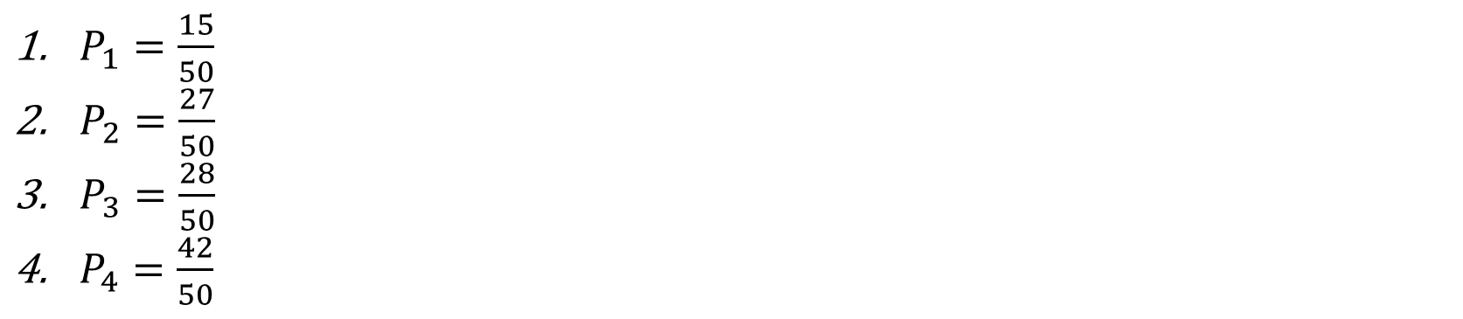
Describe what the following probabilities would represent in context to the Venn diagram using appropriate mathematical language.
$P_{1}=\frac{15}{50}$
$P_{2}=\frac{27}{50}$
$P_{3}=\frac{28}{50}$
$P_{4}=\frac{42}{50}$

Slide 16
Individual practice

